Slide 1
Welcome to Marketing Management
Dr. Cecilia Ruvalcaba
BUSI 107 Week 6, Day 1

Slide 2
Chapter 4: Marketing Ethics

Slide 3
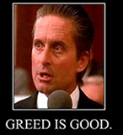
Profit vs. ethics or profit & ethics
Greed and short term profit seeking
Serious long term consequences
Creating value over the long run
Long term success
Building and maintaining consumer trust is a worthy investment!

Slide 4
Marketing Ethics
Product
Place
Price
Promotion

Slide 5

The Volkswagen Scandal
VW Scandal to Hurt Its Financing Arm
Volkswagen Scandal Casts Pall of Gloom Over Automaker's ...
The Environmental Legacy of the Volkswagen Scandal
Legal woes mounting for Volkswagen as criminal cases loom
How VW's scandal threatens the reputation of 'German engineering'
The Guardian view on the VW scandal: punish the guilty
“In less than a week, the scandal has battered the reputation that the entire Germany auto industry”
Notes:
Volkswagen: The scandal explained
http://www.bbc.com/news/business-34324772
http://www.bbc.com/news/business-34373637
How VW’s scandal threatens the reputation of ‘German engineering
http://www.washingtonpost.com/news/wonkblog/wp/2015/09/23/what-the-volkswagon-scandal-means-for-germanys-economy-and-the-rest-of-europe/

Slide 6
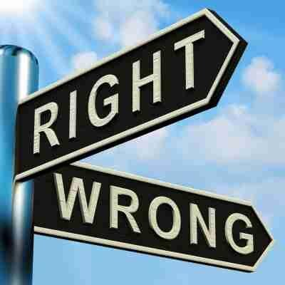
Ethical Decision Making Starts at the top
Values
Establish
Share
Understand
Rules
Management commitment
Employee dedication
Controls
Reward
Punishment

Slide 7

The Influence of Personal Ethics
Culture
Family
Religion
Values

Slide 8

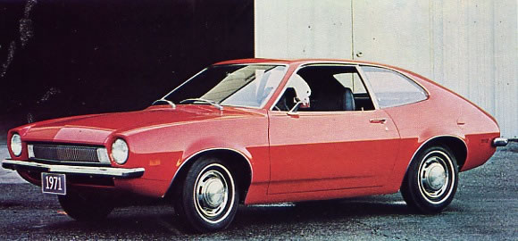
Competing Outcomes
Potentially dangerous flaw in new model
Delay production
Delayed revenue
Possible layoffs
Loss of bonuses
Continue production
Potential injury to consumers
Loss of revenue

Slide 9
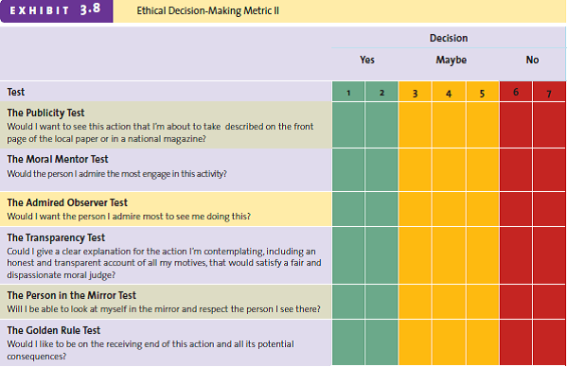

Slide 10


Take Away for Today
Ethical Decision Making
A great opportunity to build a long-term relationship.
What is the right answer?
As easy as this seems, things are not always black and white.
Use the tools to evaluate your decision

Slide 11

Next Class
Chapter 4 Marketing Ethics Cont…
Extended Outline due Friday 3/11

